Slide 1
Microeconomics for Business
Chapter 9 – Game Theory Part 1 (Static Games)
Games in Economics

Slide 2
Games in Economics
Strategic interactions: situations in which the interaction between two or more decision makers influences outcomes.
If each decision maker believes that the other decision makers are rational and seek to maximize their well-being, how should each decision maker take the optimizing behavior of others into account when making her own optimizing decisions?

Slide 3
Games in Economics
Game Theory: Provides an overall structure and a set of mathematical tools to model strategic interactions.
Decision makers are called players
Strategic interaction is called a game

Slide 4
Games in Economics
Cooperative Games
Groups of players can negotiate binding contracts that allow them to plan joint strategies.
Noncooperative Games
Binding contracts are not possible.
If players want to negotiate some form of agreement, the agreement only works if it is self-enforceable.

Slide 5
Games in Economics
Static Games (Simultaneous Move Games)
Each player only selects an action once, and they all
select this action at the same time.
Dynamic Games
Players move according to some sequence defined by the rules of the game.

Slide 6
Microeconomics for Business
Chapter 9 – Game Theory Part 1 (Static Games)
Description of a Game

Slide 7
Description of a Game
Describe the rules of the game:
the number of players
the actions that each player can take
the order in which players select their actions
what players know,
how players' actions influence the outcome of the game
the conclusion of the game
the payoff that each player receives given the outcome reached

Slide 8
Description of a Game
Players are decision makers
Game with n players: Player 1, Player 2, etc.
Generic player: Player i

Slide 9
Description of a Game
Each Player needs to choose an action from a set of available actions, defined by the rules of the game

Slide 10
Description of a Game
Each Player needs to choose an action from a set of available actions, defined by the rules of the game
The rules of the game also define the outcome of the game:
when and how the game ends
what is the final conclusion of the game

Slide 11
Description of a Game
Each Player receives a payoff according to this outcome.
If players are individuals: payoff is the utility each player derives from this outcome.
If players are profit maximizing firms: payoff is the profit each firm receives at the end of the game

Slide 12
Description of a Game
In static (or simultaneous move) games:
Each player only selects an action once
They all select this action at the same time

Slide 13
Description of a Game
Visually describe the game using a payoff matrix,
called normal form of the game.

Slide 14
Description of a Game
Player 2
 | L | R
U | 4 , 1 | 2 , 2
D | 3 , 3 | 1 , 4
Player 1

Slide 15
Description of a Game
Player 2
 | L | R
U | 4 , 1 | 2 , 2
D | 3 , 3 | 1 , 4
Player 1

Slide 16
Description of a Game
Player 2
 | L | R
U | 4 , 1 | 2 , 2
D | 3 , 3 | 1 , 4
Player 1

Slide 17
Description of a Game
Player 2
 | L | R
U | 4 , 1 | 2 , 2
D | 3 , 3 | 1 , 4
Player 1

Slide 18
Description of a Game
Player 2
 | L | R
U | 4 , 1 | 2 , 2
D | 3 , 3 | 1 , 4
Player 1

Slide 19
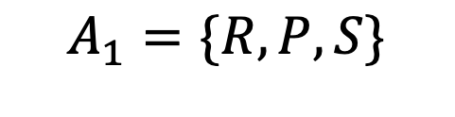

Description of a Game
Game:
Simultaneous move game between two players.
Available actions:

Slide 20
Description of a Game
Game:
Simultaneous move game between two players.
Available actions:
Payoffs are:
Winner: +1
Loser: -1
Tie: 0

Slide 21
Description of a Game
Game:
Player 2
 | R | P | S
R
P
S
Player 1

Slide 22
Description of a Game
Game 3:
Player 2
 | R | P | S
R | 0 , 0
P
S
Player 1

Slide 23
Description of a Game
Game 3:
Player 2
 | R | P | S
R | 0 , 0
P |  | 0 , 0
S
Player 1

Slide 24
Description of a Game
Game 3:
Player 2
 | R | P | S
R | 0 , 0
P |  | 0 , 0
S |  |  | 0 , 0
Player 1

Slide 25
Description of a Game
Game 3:
Player 2
 | R | P | S
R | 0 , 0
P |  | 0 , 0
S |  |  | 0 , 0
Player 1

Slide 26
Description of a Game
Game 3:
Player 2
 | R | P | S
R | 0 , 0
P | 1 , -1 | 0 , 0
S |  |  | 0 , 0
Player 1

Slide 27
Description of a Game
Game 3:
Player 2
 | R | P | S
R | 0 , 0 | -1 , 1 | 1 , -1
P | 1 , -1 | 0 , 0 | -1 , 1
S | -1 , 1 | 1 , -1 | 0 , 0
Player 1

Slide 28
Microeconomics for Business
Chapter 9 – Game Theory Part 1 (Static Games)
Strategies and Best Responses

Slide 29
Strategies and Best Responses
Actions vs. Strategies

Slide 30
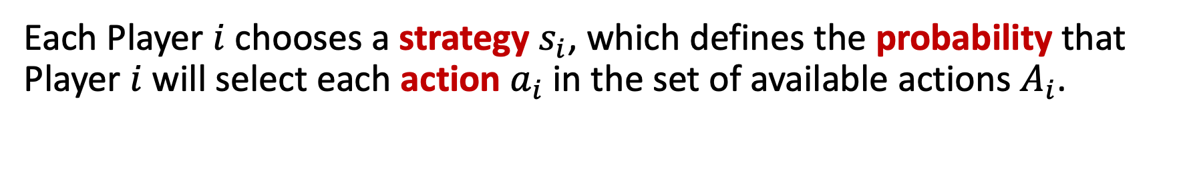
Strategies and Best Responses

Slide 31
Strategies and Best Responses
Pure strategy: assigns probability 100% to a particular action and zero to all others.

Slide 32
Strategies and Best Responses
Pure strategy: assigns probability 100% to a particular action and zero to all others.
Mixed strategy: assigns positive probability to two or more actions.

Slide 33
Strategies and Best Responses
Actions | Probability
Rock | 100%
Paper | 0%
Scissors | 0%
Pure strategy

Slide 34
Strategies and Best Responses
Actions | Probability
Rock | 100%
Paper | 0%
Scissors | 0%
Actions | Probability
Rock | 50%
Paper | 50%
Scissors | 0%
Pure strategy
Mixed strategy

Slide 35
Strategies and Best Responses
Each Player wants to maximize his own the expected payoff.

Slide 36
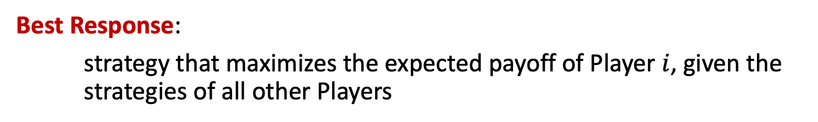
Strategies and Best Responses
Each Player wants to maximize his own the expected payoff.

Slide 37
Description of a Game
Player 2
 | L | R
U | 4 , 1 | 2 , 2
D | 3 , 3 | 1 , 4
Player 1

Slide 38
Description of a Game
Player 2
 | L | R
U | 4 , 1 | 2 , 2
D | 3 , 3 | 1 , 4
Player 1

Slide 39
Description of a Game
Player 2
 | L | R
U | 4 , 1 | 2 , 2
D | 3 , 3 | 1 , 4
Player 1

Slide 40
Description of a Game
Game 2:
Player 2
 | L | R
U | 4 , 1 | 2 , 2
D | 3 , 3 | 1 , 4
Player 1

Slide 41
Description of a Game
Player 2
 | L | R
U | 4 , 1 | 2 , 2
D | 3 , 3 | 1 , 4
Player 1
If Player 2 plays L, then BR₁ is U

Slide 42
Description of a Game
Player 2
 | L | R
U | 4 , 1 | 2 , 2
D | 3 , 3 | 1 , 4
Player 1

Slide 43
Description of a Game
Player 2
 | L | R
U | 4 , 1 | 2 , 2
D | 3 , 3 | 1 , 4
Player 1
If Player 2 plays R, then BR₁ is U

Slide 44
Description of a Game
Player 2
 | L | R
U | 4 , 1 | 2 , 2
D | 3 , 3 | 1 , 4
Player 1
If Player 2 plays L, then BR₁ is U
If Player 2 plays R, then BR₁ is U

Slide 45
Description of a Game
Game 2:
Player 2
 | L | R
U | 4 , 1 | 2 , 2
D | 3 , 3 | 1 , 4
Player 1
If Player 2 plays L, then BR₁ is U
If Player 2 plays R, then BR₁ is U

Slide 46
Strategies and Best Responses
Game 3:
Opponent | BR_{i}
Rock
Paper
Scissors

Slide 47
Strategies and Best Responses
Game 3:
Opponent | BR_{i}
Rock | Paper
Paper
Scissors

Slide 48
Strategies and Best Responses
Game 3:
Opponent | BR_{i}
Rock | Paper
Paper | Scissors
Scissors

Slide 49
Strategies and Best Responses
Game 3:
Opponent | BR_{i}
Rock | Paper
Paper | Scissors
Scissors | Rock

Slide 50
Microeconomics for Business
Chapter 9 – Game Theory Part 1 (Static Games)
Nash Equilibrium

Slide 51
Nash Equilibrium
Assumptions:
Each player chooses the strategy that maximizes his own expected payoff

Slide 52
Nash Equilibrium
Assumptions:
Each player chooses the strategy that maximizes his own expected payoff
Players understand the game

Slide 53
Nash Equilibrium
Assumptions:
Each player chooses the strategy that maximizes his own expected payoff
Players understand the game
Players understand that other players are also optimally selecting their strategies

Slide 54
Nash Equilibrium
Games: equilibrium has the meaning of balance
Strategic behavior
of the players
Conditions creating a situation in which economic forces are balanced and no further change is taking place
Nash Equilibrium

Slide 55

Nash Equilibrium
Two-player game:

Slide 56
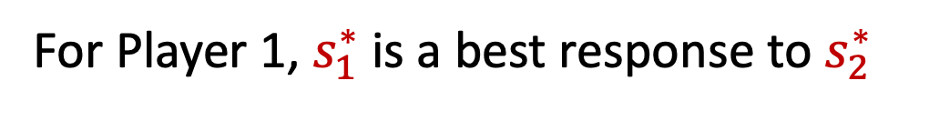
Nash Equilibrium
Two-player game:

Slide 57

Nash Equilibrium
Two-player game:

Slide 58
Nash Equilibrium
Two-player game:
Players must form correct beliefs about the equilibrium strategies of other players

Slide 59
Nash Equilibrium
Player 2
 | L | R
U | 4 , 1 | 2 , 2
D | 3 , 3 | 1 , 4
Player 1

Slide 60
Nash Equilibrium
Game 2:
Player 2
 | L | R
U | 4 , 1 | 2 , 2
D | 3 , 3 | 1 , 4
Player 1

Slide 61
Nash Equilibrium
Game 2:
Player 2
 | L | R
U | 4 , 1 | 2 , 2
D | 3 , 3 | 1 , 4
Player 1

Slide 62
Nash Equilibrium
Game 2:
Player 2
 | L | R
U | 4 , 1 | 2 , 2
D | 3 , 3 | 1 , 4
Player 1

Slide 63
Nash Equilibrium
Game 2:
Player 2
 | L | R
U | 4 , 1 | 2 , 2
D | 3 , 3 | 1 , 4
Player 1

Slide 64
Nash Equilibrium
Game 2:
Player 2
 | L | R
U | 4 , 1 | 2 , 2
D | 3 , 3 | 1 , 4
Player 1

Slide 65
Nash Equilibrium
Game 2:
Player 2
 | L | R
U | 4 , 1 | 2 , 2
D | 3 , 3 | 1 , 4
Player 1

Slide 66
Nash Equilibrium
Game 2:
Player 2
 | L | R
U | 4 , 1 | 2 , 2
D | 3 , 3 | 1 , 4
Player 1

Slide 67
Nash Equilibrium
Game 2:
Player 2
 | L | R
U | 4 , 1 | 2 , 2
D | 3 , 3 | 1 , 4
Player 1

Slide 68
Nash Equilibrium
Game 2:
Player 2
 | L | R
U | 4 , 1 | 2 , 2
D | 3 , 3 | 1 , 4
Player 1

Slide 69
Nash Equilibrium
Game 2:
Player 2
 | L | R
U | 4 , 1 | 2 , 2
D | 3 , 3 | 1 , 4
Player 1

Slide 70
Nash Equilibrium
Game 2:
Player 2
 | L | R
U | 4 , 1 | 2 , 2
D | 3 , 3 | 1 , 4
Player 1

Slide 71
Nash Equilibrium
Game 2:
Player 2
 | L | R
U | 4 , 1 | 2 , 2
D | 3 , 3 | 1 , 4
Player 1

Slide 72
Nash Equilibrium
Game 2:
Player 2
 | L | R
U | 4 , 1 | 2 , 2
D | 3 , 3 | 1 , 4
Player 1

Slide 73

Game Matrix
(Group Work)
Find any/all Nash Equilibrium in the following simultaneous move games.
 |  | ABC Inc.
 |  | Offer Rebate | No Rebate
XYZ Corp. | Offer Rebate | 20, 10 | 30, 0
 | No Rebate | 12, 16 | 20, 4
 |  | Player 2
 |  | Left | Right
Player 1 | Up | 1, 5 | 2, 4
 | Down | 3, 2 | 1, 0
 |  | Betty
 |  | Left | Right
Andrew | Up | 0, 1 | 2, 4
 | Down | 2, 1 | 1, 0

Slide 74
Microeconomics for Business
Chapter 9 – Game Theory Part 1 (Static Games)
Prisoner’s Dilemma

Slide 75
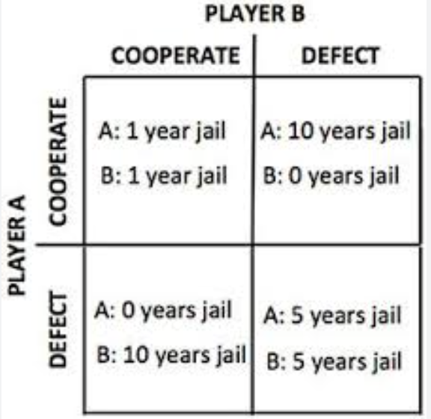
Prisoner’s Dilemma
Game: Prisoner’s Dilemma

Slide 76
Prisoner Dilemma Examples
https://www.youtube.com/watch?v=S0qjK3TWZE8
Advertising (Super Bowl)
tragedy of the commons
TikTok

Slide 77
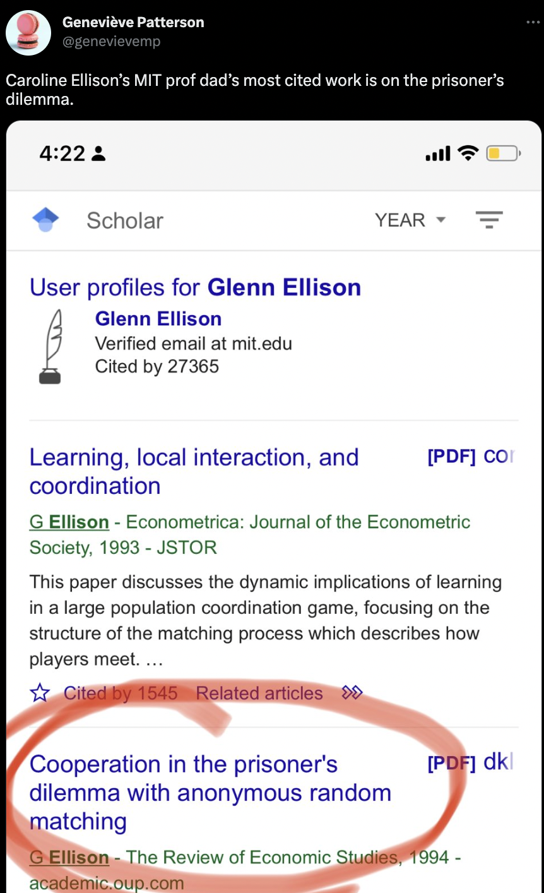
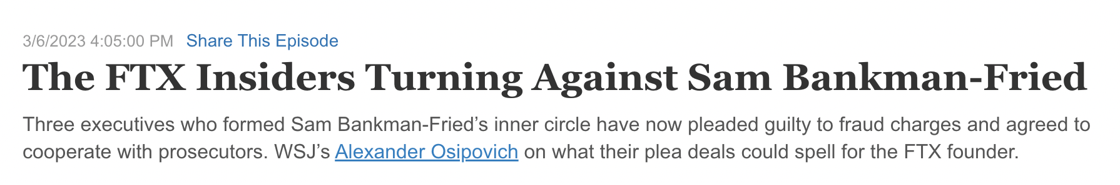
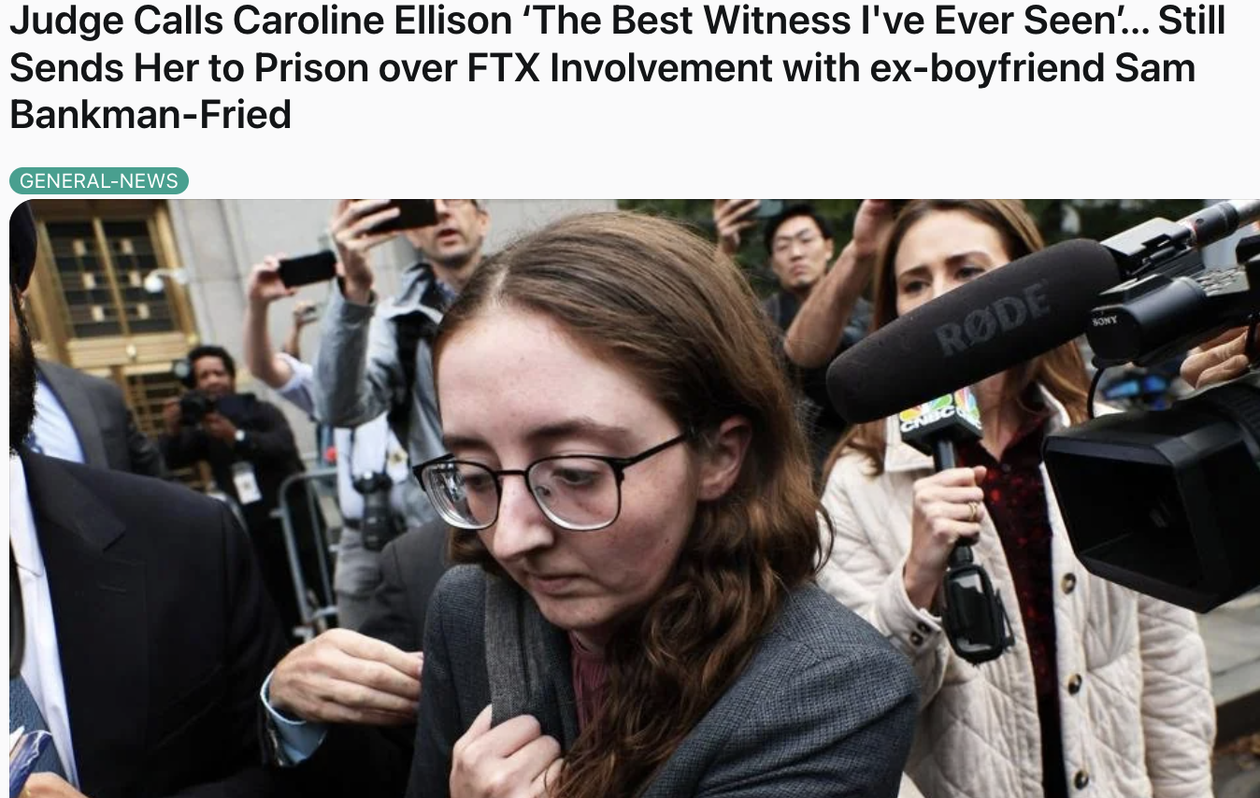

Prisoner’s Dilemma in Real Life

Slide 78
Related: Hoteling’s law
Beach

Slide 79

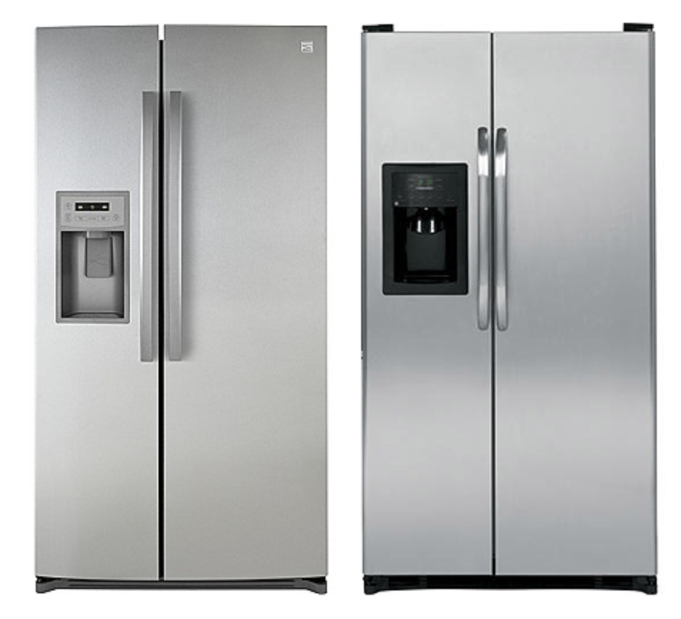
https://youtu.be/XqjyMTH0Vlo

Slide 80
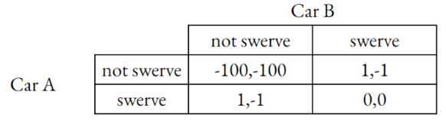
Chicken Game
Two cars are traveling towards each other, whoever turns first loses.
-1,1

Slide 81
Chicken Game
Two cars are traveling towards each other, whoever turns first loses.
-1,1

Slide 82
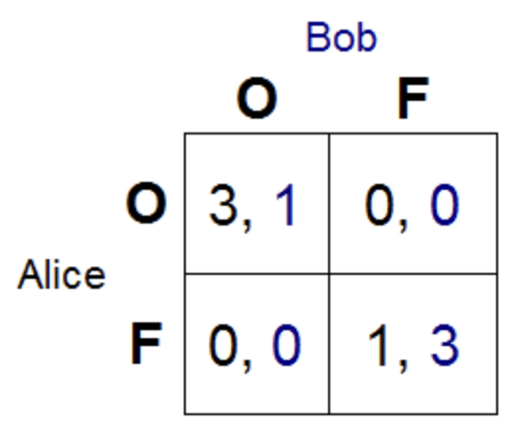
Battle of the Sexes
A couple is deciding where to eat dinner. One prefers the restaurant Olive Garden, the other Fogo di Chao

Slide 83

Let’s Play a Game
You can choose to collude or defect.
If everyone chooses to collude, I will give each of you $1.
If 3 or fewer people choose to defect, I will give them each $20 and everyone else will get $0.
If more than 3 people choose defect, everyone gets $0.

Slide 84
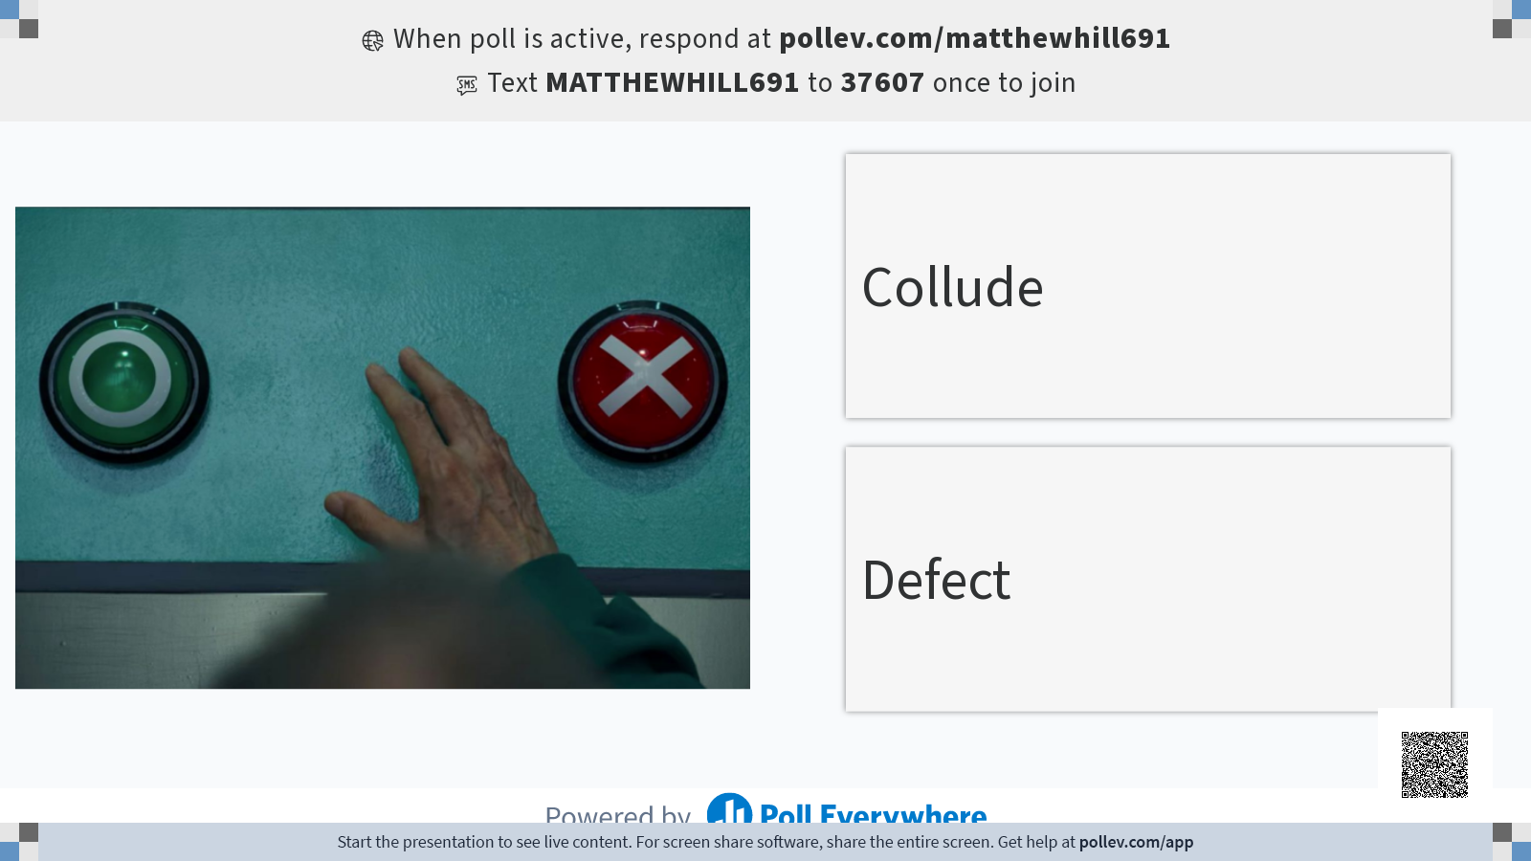

Slide 85
AGAIN?

Slide 86


Slide 87
Microeconomics for Business
Chapter 9 – Game Theory Part 1 (Static Games)
Mixed Strategies

Slide 88
Penalties
goalie
 | Left | Right
Left | (-1,1) | (1,-1)
Right | (1,-1) | (-1,1)
kicker

Slide 89
Penalties
goalie
 | Left | Right
Left | (-1,1) | (1,-1)
Right | (1,-1) | (-1,1)
kicker

Slide 90
Mixed Strategies
Player 2
 | L | R
U | 0 , 1 | 1 , 0
M | 1 , 1 | 1 , 0
D | 2 , 0 | 0 , 1
Player 1

Slide 91
Mixed Strategies
Player 2
60%
40%
 | L | R
U | 0 , 1 | 1 , 0
M | 1 , 1 | 1 , 0
D | 2 , 0 | 0 , 1
Player 1

Slide 92
Mixed Strategies
Player 2
60%
40%
 | L | R
U | 0 , 1 | 1 , 0
M | 1 , 1 | 1 , 0
D | 2 , 0 | 0 , 1
Player 1

Slide 93
Mixed Strategies
Player 2
60%
40%
 | L | R
U | 0 , 1 | 1 , 0
M | 1 , 1 | 1 , 0
D | 2 , 0 | 0 , 1
Player 1

Slide 94

Mixed Strategies
Player 2
60%
40%
 | L | R
U | 0 , 1 | 1 , 0
M | 1 , 1 | 1 , 0
D | 2 , 0 | 0 , 1
Player 1

Slide 95
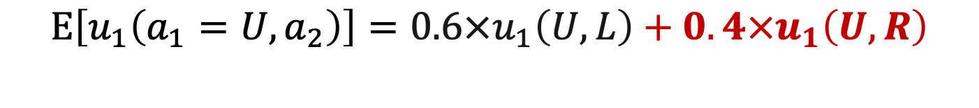
Mixed Strategies
Player 2
60%
40%
 | L | R
U | 0 , 1 | 1 , 0
M | 1 , 1 | 1 , 0
D | 2 , 0 | 0 , 1
Player 1

Slide 96
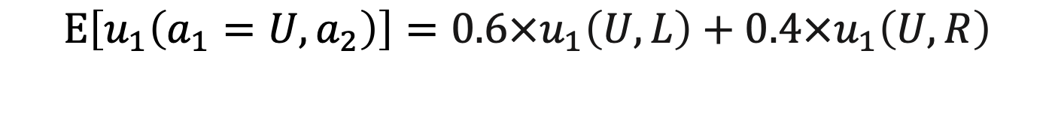
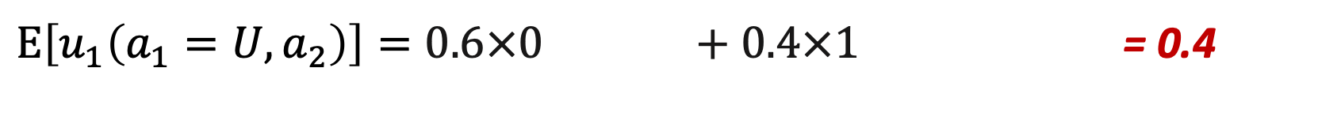
Mixed Strategies
Player 2
60%
40%
 | L | R
U | 0 , 1 | 1 , 0
M | 1 , 1 | 1 , 0
D | 2 , 0 | 0 , 1
Player 1

Slide 97
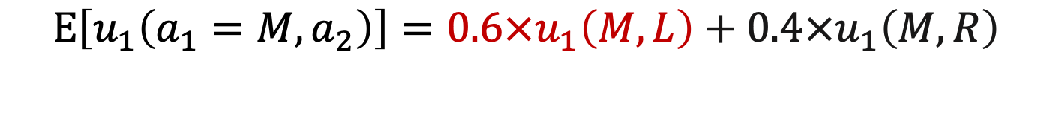
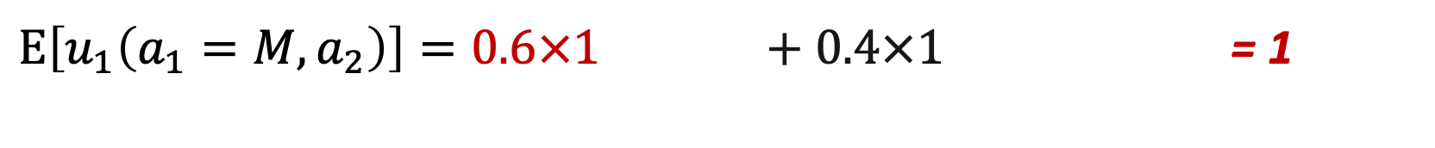
Mixed Strategies
Player 2
60%
40%
 | L | R
U | 0 , 1 | 1 , 0
M | 1 , 1 | 1 , 0
D | 2 , 0 | 0 , 1
Player 1

Slide 98

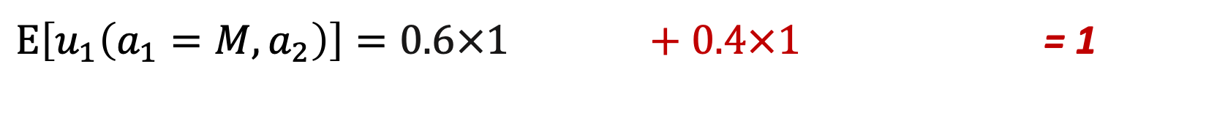
Mixed Strategies
Player 2
60%
40%
 | L | R
U | 0 , 1 | 1 , 0
M | 1 , 1 | 1 , 0
D | 2 , 0 | 0 , 1
Player 1

Slide 99
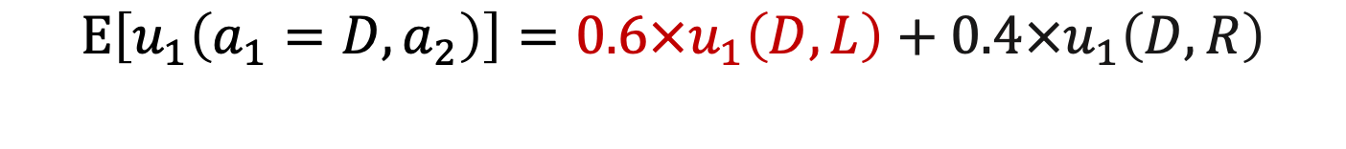
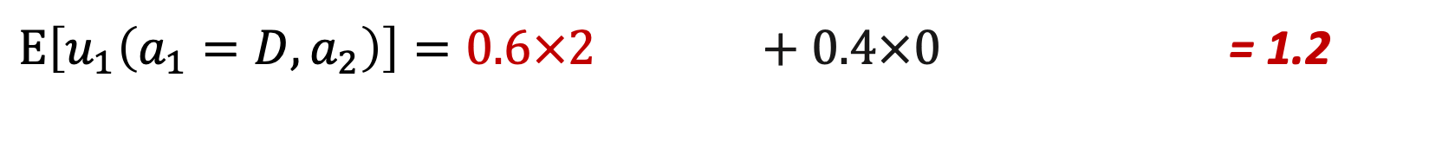
Mixed Strategies
Player 2
60%
40%
 | L | R
U | 0 , 1 | 1 , 0
M | 1 , 1 | 1 , 0
D | 2 , 0 | 0 , 1
Player 1

Slide 100
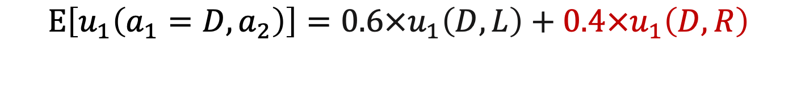
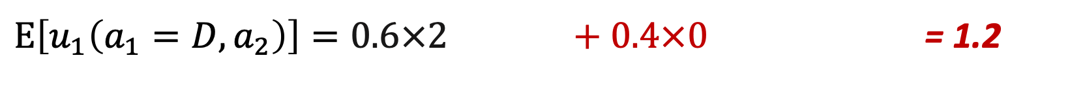
Mixed Strategies
Player 2
60%
40%
 | L | R
U | 0 , 1 | 1 , 0
M | 1 , 1 | 1 , 0
D | 2 , 0 | 0 , 1
Player 1

Slide 101
Mixed Strategy Equilibrium
https://www.youtube.com/watch?v=ZC_Hul1jUQM

Slide 102
Penalties
if the goalie goes left ⅓ of the time and right ⅔ of the time, what is the kicker’s best response?
Is this strategy part of a Nash eq?
If the kicker goes left ⅗ and right ⅖, what is the goalie’s best response?
Is this strategy part of a Nash eq?
goalie
 | Left | Right
Left | (-3,1) | (3,-1)
Right | (1,-2) | (-1,1)
kicker

